Slide 1
Analysis of Medicare Claims Data
By:
Madhumitha Sai Srija Ganta

Slide 2
Problem Statement
The Cardiovascular Metabolic (CVM) diseases are a cluster of conditions and risk factors that increase the likelihood of developing heart disease, stroke, and/or type 2 diabetes. It is characterized by a combination of several interconnected metabolic abnormalities, including Obesity, Insulin Resistance, High Blood Pressure (Hypertension), Dyslipidemia and Elevated Fasting Blood Sugar. The presence of three or more of these factors is typically used to diagnose this metabolic syndrome. Most common CVM diseases and conditions include heart diseases like coronary artery disease, Stroke, Type 2 Diabetes, Atherosclerosis,Non-Alcoholic Fatty Liver Disease (NAFLD), Chronic Kidney Disease (CKD), Sleep Apnea, etc. Some popular
brands in the market for CVM diseases are Xarelto, Touejo, Lantus, Eliquis, Jardiance, Crestor, Metoprolol,Plavix, etc. The leadership of a Pharmaceutical Company is seeking to gain insights into the trends and landscape of medical procedures conducted in hospitals and clinics. As a member of the Commercial Analytics team, your role is to furnish the leadership with valuable insights, addressing the following Key Business Questions (KBQs) that will inform the decision-making and strategy development of the CVM Sales & Marketing leadership team

Slide 3
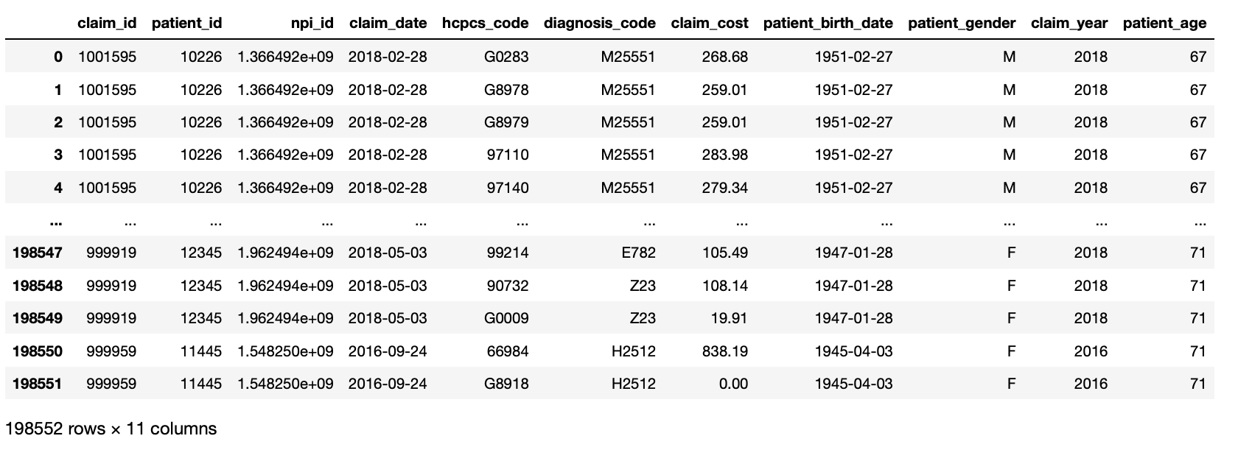
Step 1:Prepare the required dataframe to analyze by preprocessing and integrating various medicare datasets

Slide 4
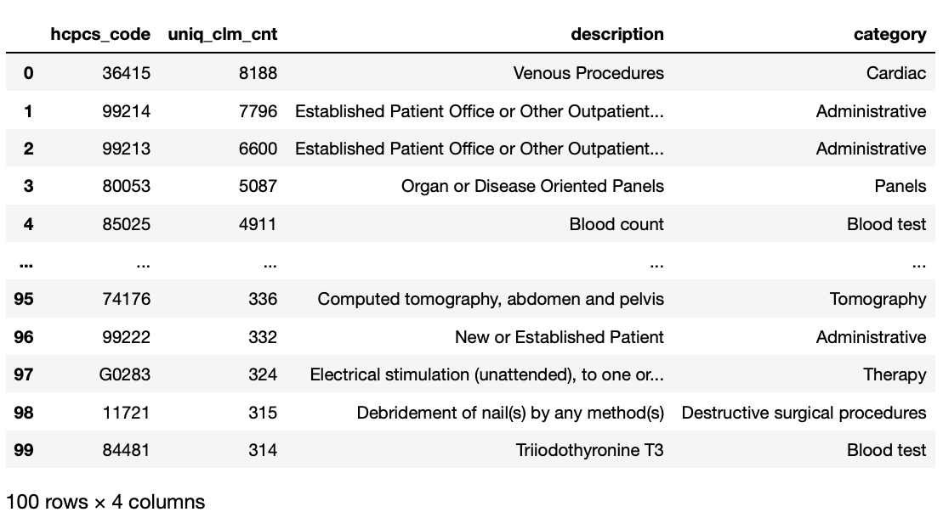
Step 2:Analyze the top 100 HCPCS/CPT codes

Slide 5
Question 1:Based on the trends for the share of CVM claims as a percentage of total claims over the years 2016 through 2018, what are some business insights you can gather? What are some additional analyses you could do based on these trends?

Slide 6
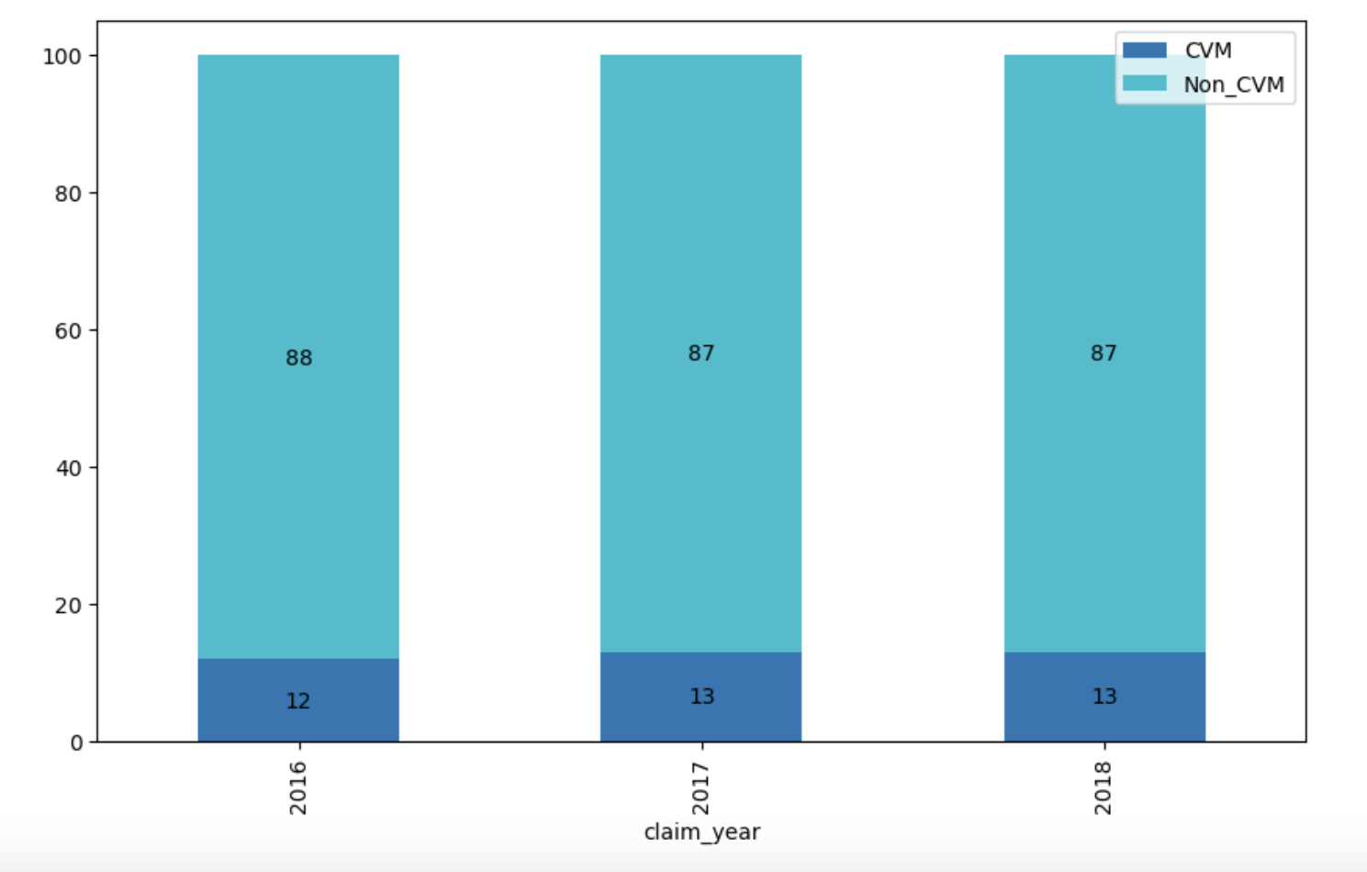
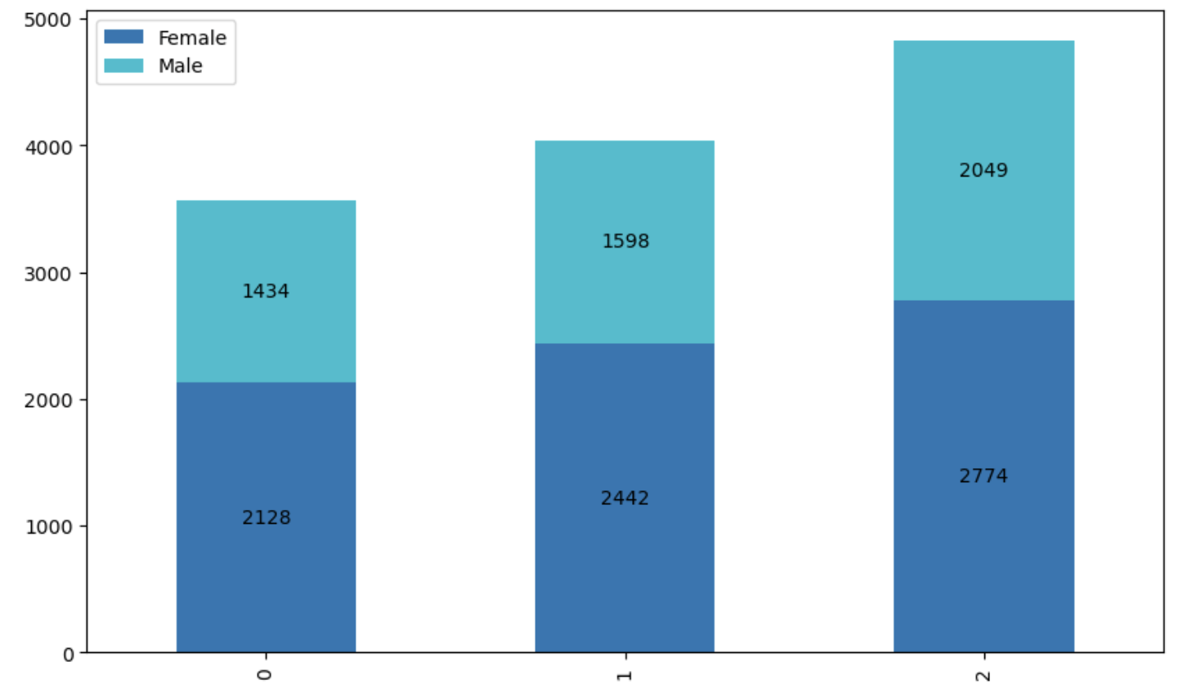
Results:
Composition Analysis of CVM and Non CVM Claims
Gender Demographics analysis of CVM Claims

Slide 7
Business Insights
Even though the share of the cardiac category in the market remains relatively stable, moving from 12% to 13% suggests a slight but significant uptick in its importance within the HCPCS/CPT categories. This could indicate a growing recognition of cardiac-related treatments or diagnostics in the healthcare market and there may be unrealized potential to increase this category even further.The sales force might need to be bolstered, especially in areas where the rise in CVM conditions is most pronounced.
The steady figures of 13% for the past two years imply that there is an ongoing demand for cardiac-related care. This suggests a steady customer base, which is advantageous for companies in this industry.
Given the cardiac categories relative stability, it's possible that neither the market nor the actions of competitors will fluctuate significantly in relation to this particular segment. To make sure their competitors keep or expand their market share, companies need, nevertheless, keep a close eye on their tactics.
The gender demographics analysis of the patients shows that there is an steady increase in the number of CVM claims for both genders. Nonetheless, a higher percentage of women than men account for CVM claims and the gap between female and male CVM claims appears to be widening.This might suggest that women are either more susceptible to CVM conditions, or they are more proactive in seeking medical care for these conditions than their male counterparts.

Slide 8
Business Insights
Sales and marketing materials should be customized to target female-specific concerns, risk factors, and treatment alternatives because females seem to have a higher prevalence of CVM claims.
The Non-CVM category, which holds a dominating 87-88% of the market share, accounts for the vast majority of claims.This could indicate that the market is heavily oriented towards non-cardiac vascular metabolism related services.
The majority of the sales team must be dedicated to non-CVM claims while making sure CVM isn't neglected.
Use materials designed for patients with and without CVM to improve the patient experience. Given the significant gender gap in CVM claims,we need to develop materials tailored to a particular gender while keeping in mind the age demographics.
Divide the market of CVM and Non CVM based on geographics,revenue etc and evaluate the segments to allocate the necessary team of sales reps.

Slide 9
Question 2:Evaluate the HCP behavior in context of claim volume from 2016-2018. How many HCPs are submitting 1 CVM claim; how many HCPs are associated with more than 10 claims, etc.? Once you perform this analysis, explain how this trend can influence the sales force deployment. That is,how would you segment the HCPs and how would you allocate In-Person (sales force) vs Non-Personal Promotions (NPP, i.e. Emails, Social Media, Digital etc.)
efforts?

Slide 10
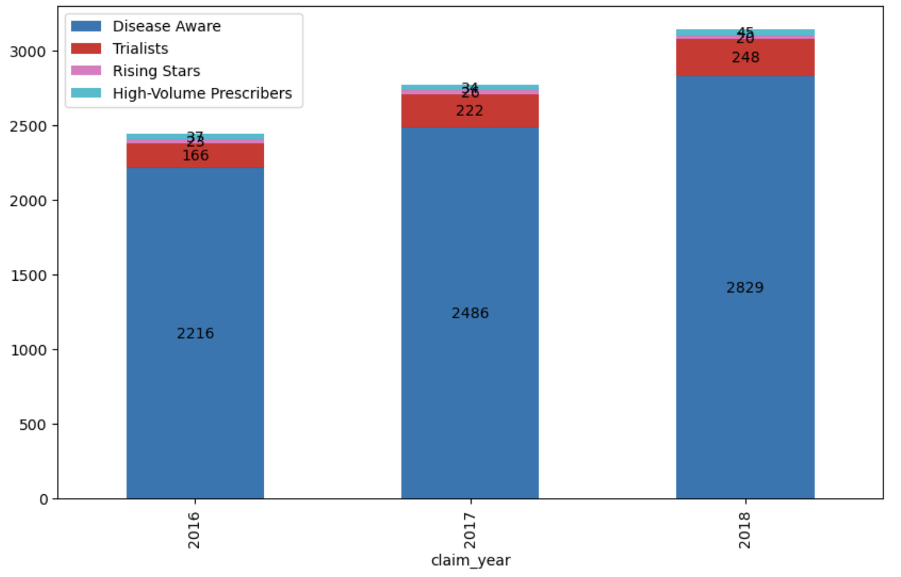
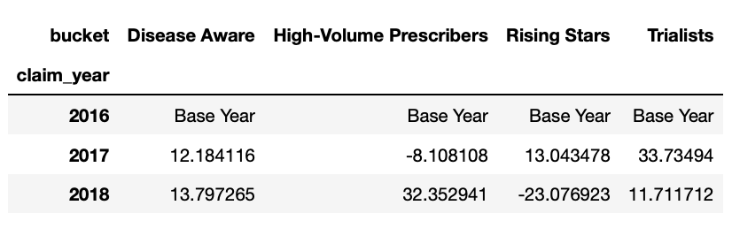
Results:
Growth Rate Analysis of the given categories of HCPs prescribing CVM meds over the years
Composition Analysis of given categories of HCP’s prescribing CVM meds over the years

Slide 11
Business Insights
Disease Aware segment has been growing consistently over the years.It shows that, even if the number of HCPs who are prescribing CVM drugs is still small, more healthcare professionals are becoming aware of them and doing so.Since HCPs are just starting to prescribe CVM drugs to patients, sales representatives need to focus on educating HCPS about their product, benefits, and patient success stories. This needs to be done to a large volume of people therefore non personal promotions would be ideal.
The Trailists segment is gradually expanding, which suggests that a shift from Disease Aware HCPs to Trialists is taking place.These professionals are getting more comfortable and trying out the medication more frequently.However there is a noticeable disparity in the numbers of disease aware HCPs and trailists.This group needs encouragement to prescribe more frequently. Sales Representatives need to provide workshops, product insights, and training sessions. It would be best to combine NPP for ongoing interaction with in-person visits to foster relationships.

Slide 12
Business Insights
Growth in the Rising Stars segment is noteworthy, but it is happening more slowly than in the Trialists segment. This suggests that fewer Trialists are transitioning into Rising Stars.Rising Stars require a higher focus on in-person visits to nurture the relationship, given their potential to become High-Volume prescribers.Sales Representatives need to provide them with advanced training, opportunities for peer networking, and acknowledgement of their increasing importance.
High Volume Prescribers have seen a consistent increase in numbers.This group is important since they have an important role in whether or not CVM drugs are prescribed.The sales force should prioritize High-Volume Prescribers by making more in-person visits and implementing tailored NPP campaigns.They must be provided with new research

Slide 13
Question 3:Evaluate the Patient Age demographics in the context of claim volume from 2016-2018. Bucket the patients into groups based on their age and explain the trends. How would you position the Marketing Budgets and the Promotions with respect to the changing landscape of the CVM claims and the respective patient segments?

Slide 14
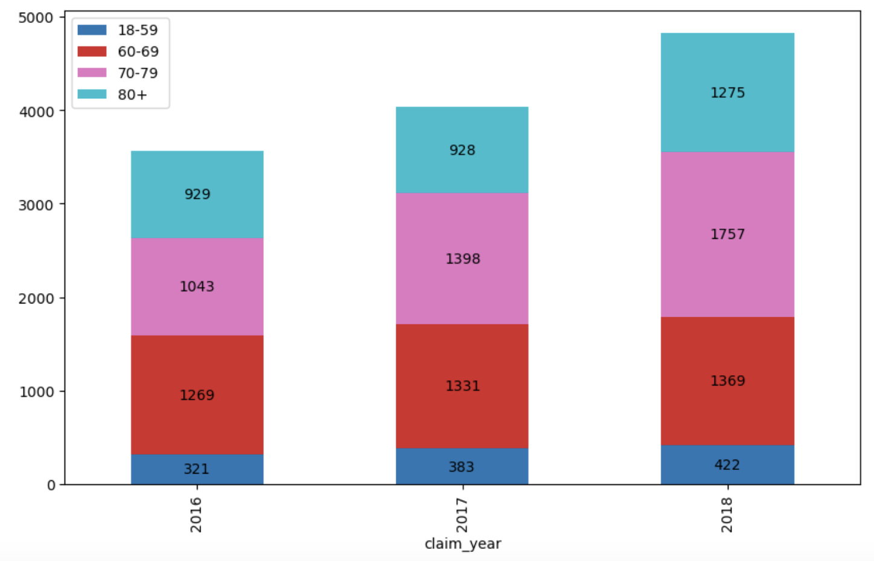
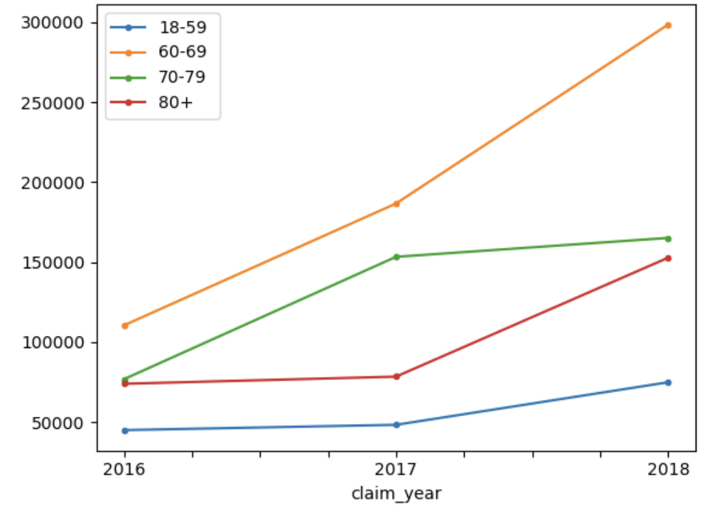
Results:
Composition Analysis of different age groups taking the cardiac meds over the years
Cost Analysis of different age groups spending on the cardiac meds over the years

Slide 15
Business Insights
While there are fewer claims made annually in the 18–59 age range than in any other, the number of claims appears to be rising. Simultaneously, the expenses linked to these claims are minimal and gradually rise annually.Tailoring campaigns to address the needs and concerns of this demographic, possibly highlighting the benefits and importance of early medication or preventive care, can be effective.
The age groups 60-69, 70-79, and 80+ experience constant increases in claims, with those over 60-69 earning the most.
Among the elder age categories, 70-79 has experienced the greatest increase in claims each year.
80+ bucket did not increase in claims from 2016 to 2017, but it did significantly increase the following year.
The 18–59 age group is small, but there is room for market penetration.Online advertising, partnerships with wellness or fitness influencers, gyms, outlets, and campaigns that highlight preventative health measures are a few examples of strategies given the fact that its a young demographics.
For stable old segments 60-69,70-79 and 80+, sales must focus on maintaining their trust and will benefit from traditional advertising campaigns like health awareness campaigns, community outreach programs, educational programs that highlight the advantages and significance of CVM drugs. Here, workshops, lectures, and educational pamphlets can be effective.

Slide 16
Business Insights
Allocate a larger portion of the money to the 70-79,60-69 age ranges because they are a growing and are the highest earners. By doing so, you can take advantage of the momentum and even increase the segment's share.
Keep the current budgetary allotments in place in light of the elder segments' steady and growing demand. Retention and ongoing education are the main priorities here.
Given the increase in claim costs, it might be valuable to provide information on cost-effective treatment options or preventive measures to avoid costly treatments in the future.There's a noticeable increase in claim costs for almost all age segments. Tailoring promotions and services to cater to this demographic might be beneficial.
Implementing feedback mechanisms will be helpful to understand the effectiveness of the marketing strategies and promotions.
Take into account time-limited deals,specialized offers or promotions aimed at particular age groups.

Slide 17
Thanks!

